Slide 1
Introduction
Kampala Advanced Trauma Care Course
Last Edited November 2018

Slide 2
Initial Trauma Assessment
Welcome to the
Kampala Advanced
Trauma Course
Kampala Advanced Trauma Care Course
Last Edited August 2016 by Maija Cheung MD & Michael DeWane MD

Slide 3
Overview
Background
Plan for Course

Slide 4
Global context and epidemiology
Traumatic injury and violence accounts for approximately 5.8 million deaths per year - 32% more than malaria, tuberculosis and HIV/AIDS combined!
Road traffic accidents alone are the number one cause of death among people age 15-29
United Nations: Goal to cut the number deaths and injuries from road traffic accidents in half by

Slide 5
Epidemiology
In Kampala - 25% of deaths are due to injury
Road traffic accidents are the number one cause of injury
At Mulago - trauma accounts for 30% of all emergent admissions and 50% of non-obstetric emergency operations.
Cost of treating one Boda Boda victim is > 700,000 UGX

Slide 6
Trauma Courses
Dedicated comprehensive trauma care services run by well trained staff are known to improve patient outcomes.
Acute Trauma Life Support (ATLS) of the American College of Surgeons has reduced trauma related mortality by 30-50 %
However, ATLS is designed for high-resource settings

Slide 7
KATC
First developed in 2007 in collaboration with surgeons and anesthesiologists from GPAS and local Ugandan Faculty
Has been administered to all interns rotating through surgery at Mulago National Referral Hospital → more than 800 people in total!
Includes lectures and simulation sessions

Slide 8
Course Objectives
Equip multiple cadres of providers with relevant knowledge and skills to:
assess the injured patient
Resuscitate the injured patient
Identify all injuries
Organize for appropriate consultation, transfer and referrals

Slide 9
Goals
This is expected to:
Lead to early and appropriate management of the injured patient
Reduce mortality
Improve patient outcome

Slide 10
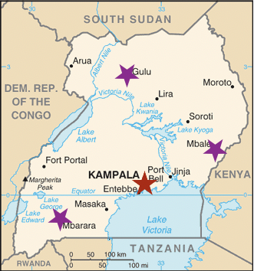
Scale - Up
Aim to establish dedicated training centers at key sites throughout Uganda

Slide 11
Funding
Special Thank You to the Laura Case Trust
Laura Cause was a British medical student who had had been working at a hospital in Kisiizi during her medical training
She was killed in a traffic accident there in February 2007, just after her 24th birthday.
Her family and friends have set up the Trust to celebrate Laura's life and to support projects she would have felt were important

Slide 12
Implementation Study
As we scale up-the course and offer it to more cadres, we would like to assess the course to make it as effective as possible
Optional study where you will be given a tablet computer and asked to take an online survey at regular intervals
Completely optional, will not effect your ability to participate in the course

Slide 13
Initial Trauma Assessment
Tablet Based Survey Tutorial
Kampala Advanced Trauma Care Course
Last Edited August 2016 by Maija Cheung MD & Michael DeWane MD

Slide 14
1.) Press Button on top right of screen to turn on (you may need to hold this down)
2.) On the touch screen, swipe up to unlock the screen

Slide 15
3.) Select the Offline Qualtrics App

Slide 16
4.) Make sure to click the refresh button
5.) Then select the correct survey to complete

Slide 17
You will get a screen like this when the survey is downloading

Slide 18
5.) Select take survey

Slide 19
1.) When the survey is done
select the X to exit the survey

Slide 20
2.) Upload Response

Slide 21
3.) Make sure that the response was uploaded

Slide 22
4.) You can then close the screen and exit the app

