Slide 1
Airway Management
Kampala Advanced Trauma Care Course

Slide 2
Outline
Global context
Airway Anatomy
Management strategies/ Ideal treatment
Adaptations for resource-limited settings/ context appropriate treatment
Case for discussion

Slide 3
Goals:
Identify clinical situations in which airway compromise can occur
Recognize signs of airway obstruction
Understand and demonstrate techniques for airway management
Describe steps for a rapid sequence intubation

Slide 4
Global Context/ Importance:
Inadequate delivery of oxygenated blood to the brain and vital organs is the fastest killer of injured patients therefore supplemental oxygen should be administered to all trauma patients
Early preventable deaths from airway problems from trauma often result from:
Failure to recognize the need for an airway intervention
Inability to establish an airway
Failure to recognize an inappropriately placed airway
Failure to recognize the need for an alternative airway plan after repeated failed intubation attempts
Displacement of a previously established airway
Aspiration

Slide 5
Initial Trauma Assessment
Initial Airway Assessment
Kampala Advanced Trauma Care Course
Last Edited August 2016 by Maija Cheung MD & Michael DeWane MD

Slide 6
Remember your primary survey!
ABC’s
Airway!
Assess and reassess
If any change in patient condition, always start back at airway
Assess Patency:
Talk to the patient and stimulate a verbal response
A positive, appropriate verbal response indicates a patent airway with intact ventilation and adequate brain perfusion
Belligerent patients may in fact be hypoxic and should not be presumed intoxicated

Slide 7
Recognize Signs of Airway Obstruction:
Look:
Symmetrical rise and fall of chest, adequate chest wall excursion
Foreign bodies, blood, vomitus in oropharynx
Signs of compromise: cyanosis, altered mental status, accessory muscle use, tachypnea, hypoxia
Listen:
Stridor, hoarseness, absent air movement
Feel:
Position of trachea, subcutaneous emphysema, palpable fracture
Constant Vigilance!
In an adult, the signs of airway obstruction may NOT be present until the airway is <3mms

Slide 8
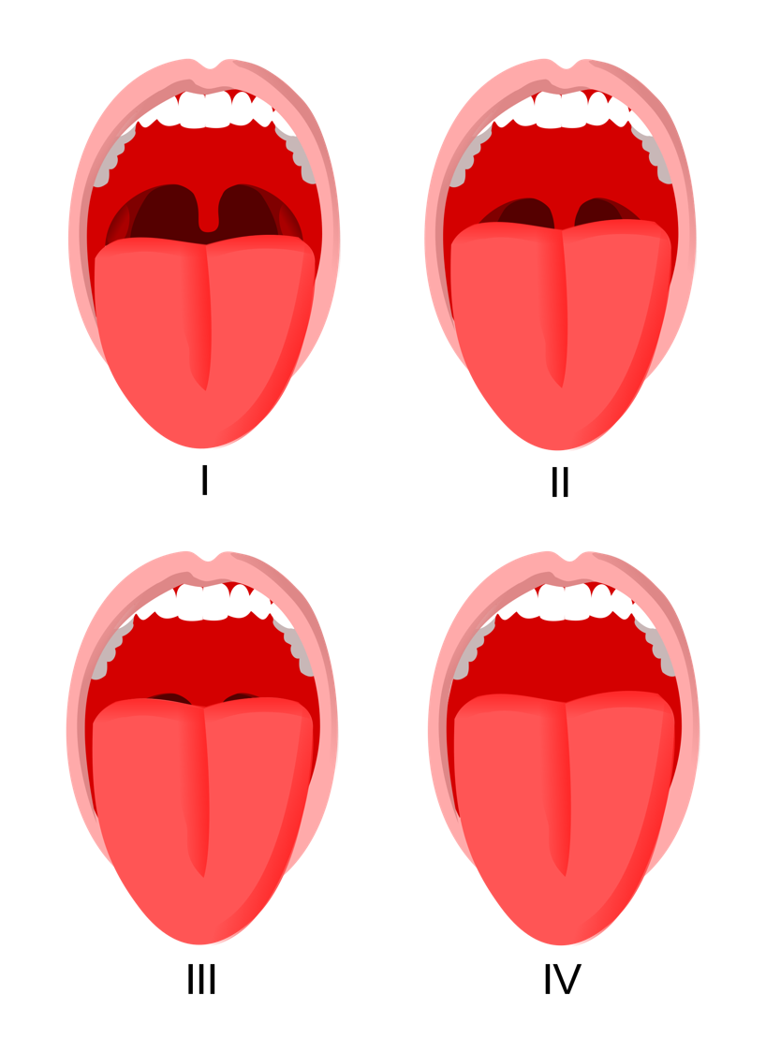
When is airway compromise likely?
Altered level of consciousness
Maxilofacial trauma
Neck trauma
Laryngeal trauma
Airway obstruction
Mallampati Scale
Mallampati Scale
Notes:
Open Access Picture: https://commons.wikimedia.org/wiki/File:Mallampati.svg

Slide 9
Initial Trauma Assessment
Airway Management
Kampala Advanced Trauma Care Course
Last Edited August 2016 by Maija Cheung MD & Michael DeWane MD

Slide 10
Establishing an Airway
Assume all trauma patients have an unstable spine until proven otherwise
Maintain c-spine precautions
Assess O2 saturation with pulse oximetry and end tidal CO2 monitoring
Supplemental oxygen – MUST be administered to all trauma patients
Nasal Cannula ~2% increase FiO2 per 1 liter per minute
Efficacy dependent on minute ventilation, nasal patency
Face Mask ~35-50% FiO2
Non-rebreather ~100% FiO2
Suction oro- and naso-pharynx
Notes:
NEED PIC
FiO₂ unpredictable
Efficacy dependent on minute ventilation, nasal patency, etc.
~2% increase FiO₂ per 1 LPM
1 LPM = 23%
2 LPM = 25%
3 LPM = 27%
4 LPM = 29%
5 LPM = 31%
6 LPM = 33%

Slide 11
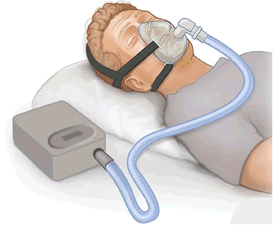
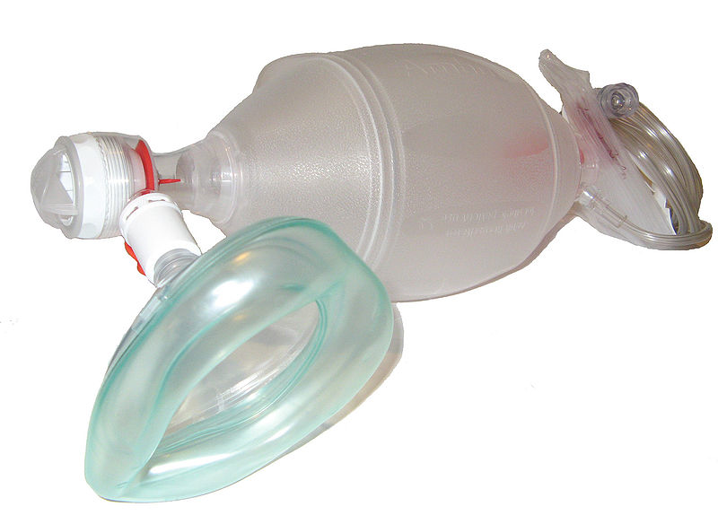
Ventilation Interventions:
Continuous Positive Airway Pressure (CPAP)
May relieve obstruction in a spontaneously ventilating patient
Bag Valve Mask
Manual ventilation; patient cannot breathe unless assisted
Self-inflating; can function on room air without gas source
Notes:
Open Access Pictures:
https://en.wikipedia.org/wiki/Positive_airway_pressure
https://de.wikipedia.org/wiki/Atemwegsmanagement
https://commons.wikimedia.org/wiki/File:Ambu_Bag_valve_mask.jpg

Slide 12
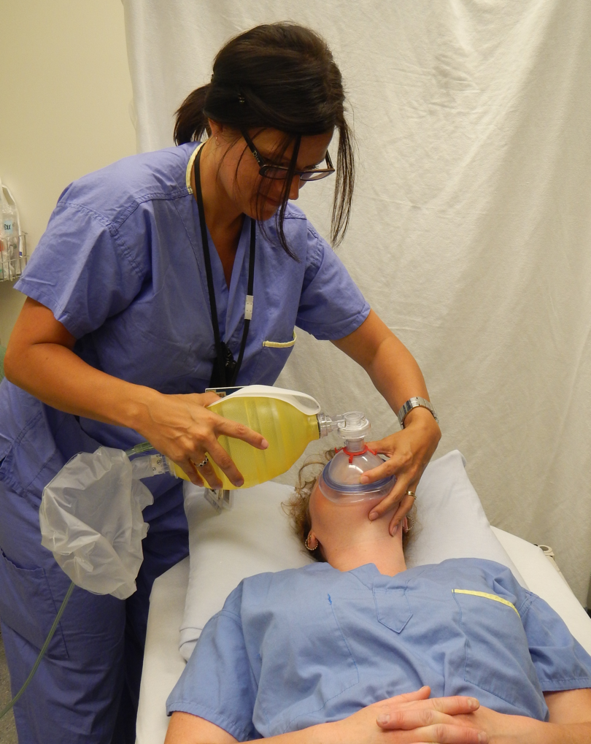
Bag Valve Mask:
“CE” Technique
“C”
Form a “C” with your thumb and index finger
Place on top of mask and press down
“E”
Take remaining three fingers and place on mandible
DO NOT compress soft tissue below mandible
If possible, wrap little finger around angle of jaw
Notes:
Open Access Picture: https://commons.wikimedia.org/wiki/File:Bagging.JPG

Slide 13
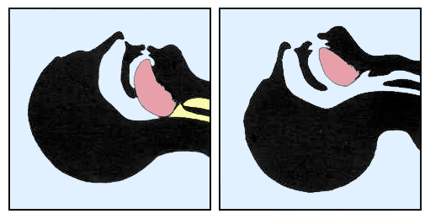
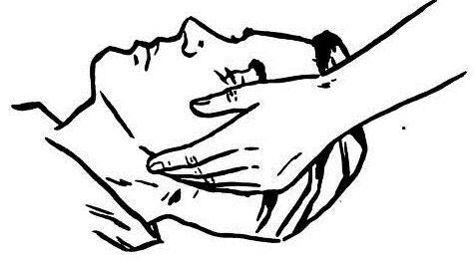
Airway Techniques
Do NOT Extend Neck
Chin-lift
Fingers placed under mandible to lift
chin anteriorly
Jaw thrust
Place two fingers behind the
angle of the mandible on each side
and displace mandible anteriorly
Notes:
Open Access Pictures:
https://en.wikipedia.org/wiki/Airway_management
https://commons.wikimedia.org/wiki/File:Jaw_thrust.jpg

Slide 14
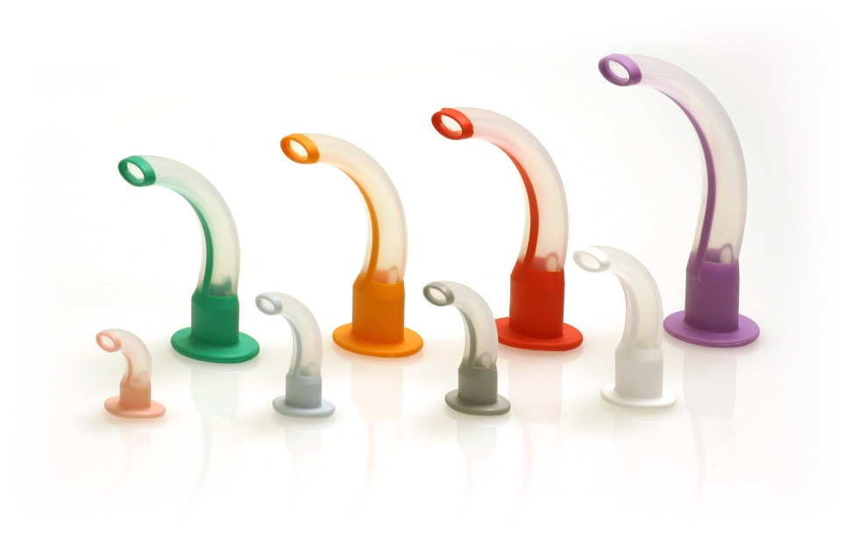
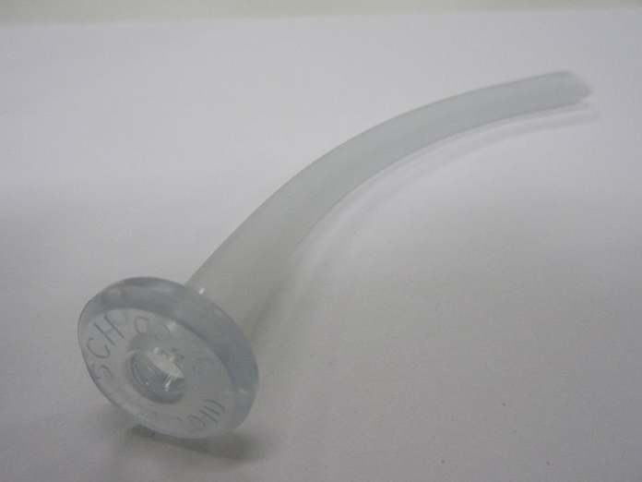
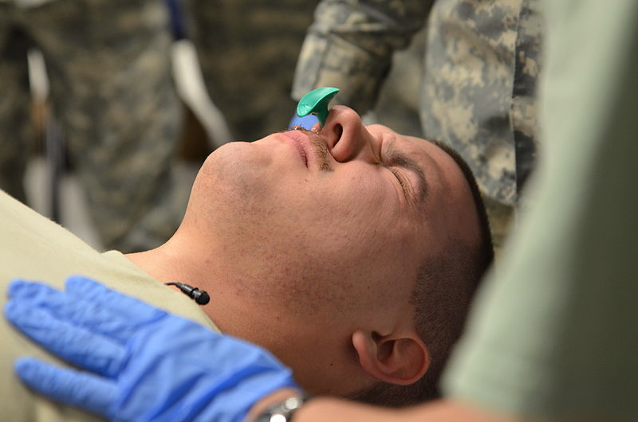
Oropharyngeal & Nasopharyngeal Airways
To insert an oropharyngeal or nasopharyngeal airway
Depress tongue out of the way so that it does not get pushed backwards and obstruct airway then insert airway posteriorly
Nasal airway can be used on conscious/semi-conscious patients, can cause nasal trauma/bleeding, do NOT use if suspected cribiform plate fracture, lubricate well and insert into unobstructed nostril.
Notes:
Open Access Pictures:
https://commons.wikimedia.org/wiki/File:One-piece_Guedel_Airways.jpg
https://commons.wikimedia.org/wiki/File:U.S._Army_Spc._Joseph_McMaster,_with_the_356th_Broadcast_Operations_Detachment_receives_a_nasopharyngeal_airway_tube,_during_the_combat_lifesaver_course,_a_pre-mobilization_class_at_Joint_Base_140111-A-RB175-611.jpg
https://commons.wikimedia.org/wiki/File:Nasopharyngeal_Airway.JPG

Slide 15
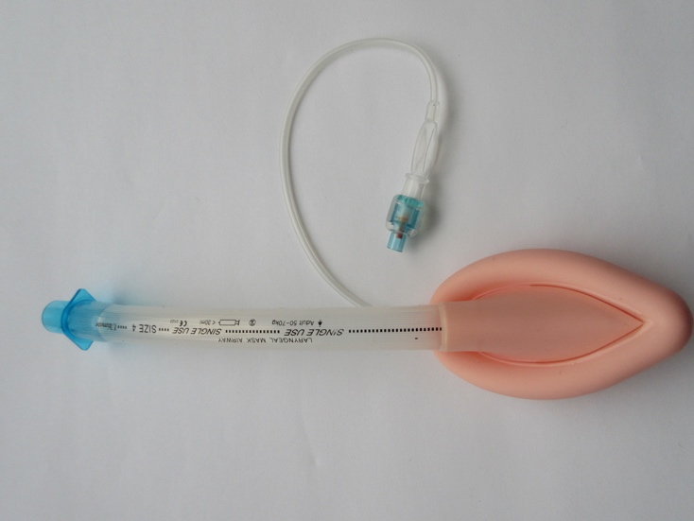
Extraglottic & Supraglottic Devices:
Used in patients who require an advanced airway adjunct but in whom intubation has failed or is unlikely to succeed.
Laryngeal Mask Airway (LMA)
Not a “protected” airway
Lubricate device
Use tongue depressor to secure tongue
Place pointed end toward hard palate, then
spin 180 degrees when entering posterior oropharynx
Inflate cuff
Add/subtract air to improve seal
Optimal seal ~ 20 cm H₂O without leak
Notes:
Open Access Picture: https://commons.wikimedia.org/wiki/File:Laryngeal_mask_airway.jpg

Slide 16
Definitive Airways
A definitive airway requires a tube placed in the trachea with the cuff inflated below the vocal cords, the tube connected to some form of oxygen-enriched assisted ventilation and the airway secured in place.
Orotracheal tubes
Nasotracheal tubes
Surgical Airways
Cricothyroidotomy
Tracheostomy

Slide 17
Indications for Endotracheal Intubation
Hypoventilation
Hypoxia
Airway Protection
Mental Status
GCS <8 = intubate
Secretions/ blood
Direct trauma, swelling, burns
Procedures
Bronchoscopy
Urgent radiologic studies in non-cooperative patient

Slide 18
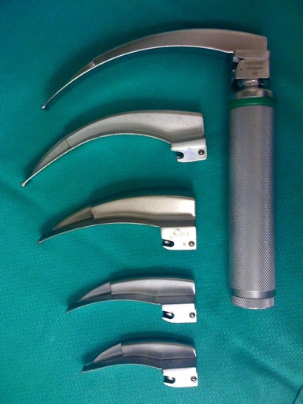
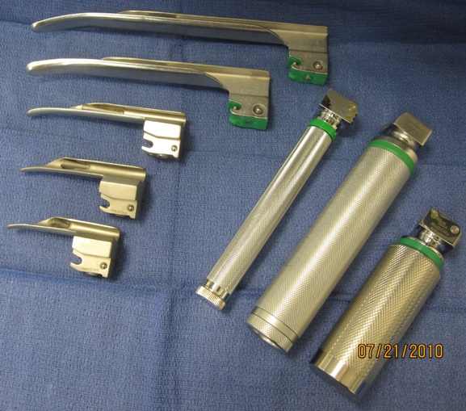
Steps for Endotracheal Intubation:
Have a plan in the event of failure that includes the possibility of performing a surgical airway
Ensure that suction and ability to delivery positive pressure ventilation
Maintain c-spine precautions at all times.
Know your equipment
Know contraindications for RSI drugs
Notes:
Open Access Pictures: https://en.wikipedia.org/wiki/Laryngoscopy

Slide 19
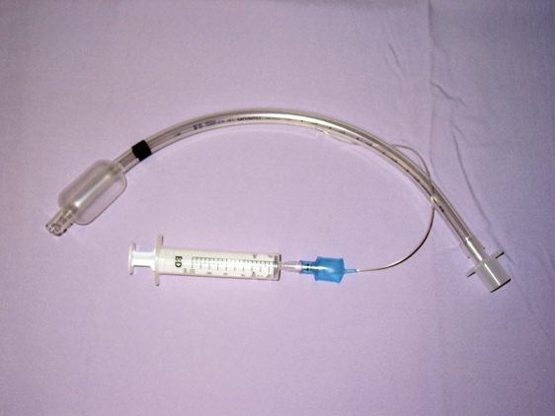
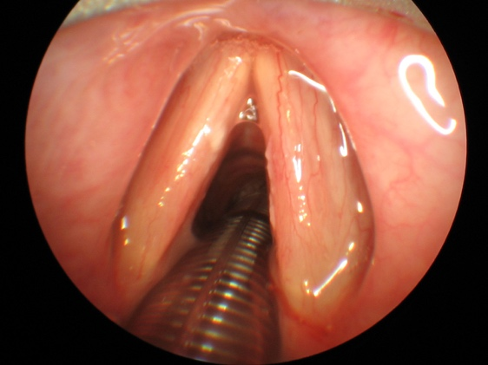
Rapid Sequence Intubation
Pre-oxygenate with 100% oxygen
Administer induction drug
Ex: etomidate 0.3 mg/kg
Administer muscle relaxant
Ex: succinylcholine 1-2mg/kg
Intubate patient orotracheally, visualize ETT passing beyond vocal cords
Inflate cuff and confirm tube placement by ascultating the chest, checking O2 saturation, and with end-tidal CO2 monitor
Attach ventilatory device to ETT
Secure tube
Continue sedation
Insert OG or NG tube and attach to suction
Notes:
Open Access Images:
https://commons.wikimedia.org/wiki/File:Sondeintubation.jpg
Preoxygenation
8 vital capacity breaths or 3 minutes on high FiO₂
Following 100% FiO₂ preoxygenation, apnea time to 90% SpO₂:
8 minutes in healthy patient
5 minutes in moderately ill patient
2.7 minutes in obese adults
If unable to preoxygenate, apnea time to 90% SpO₂ is < 1 minute

Slide 20
RSI Medication Overview:
Etomidate (0.3 mg/kg)
Etomidate can cause adrenal suppression
Propofol, thiopental, methohexital
Caution hypotension in hypovolemic patients
Ketamine
Relatively hemodynamically stable
Do not use if traumatic brain injury suspected
Succinylcholine (1-2 mg/kg, usual dose is 100mg)
Can cause hyperkalemia – avoid in crush syndrome, burn, end-stage renal patients
Rocuronium (1.2 mg/kg)
Fast onset at this dose
Long duration of action
Option if succinylcholine is contraindicated

Slide 21
Helpful Techniques
“BURP” Maneuver
Backward, upward, rightward pressure on thyroid cartilage
Cricoid pressure
Efficacy controversial
Common error: putting pressure on thyroid cartilage instead of cricoid
Video laryngoscopy or fiberoptic scope

Slide 22
Unsuccessful Intubation
Call for help
Consider removing tube and using bag-valve mask
LMA
Definitive (surgical) airway

Slide 23
Establishing a Definitive Airway
Establish a definitive airway (tube placed in trachea with cuff inflated below the vocal cords and the tube connected to a ventilation device)
Intubation
Surgical cricothyroidotomy

Slide 24
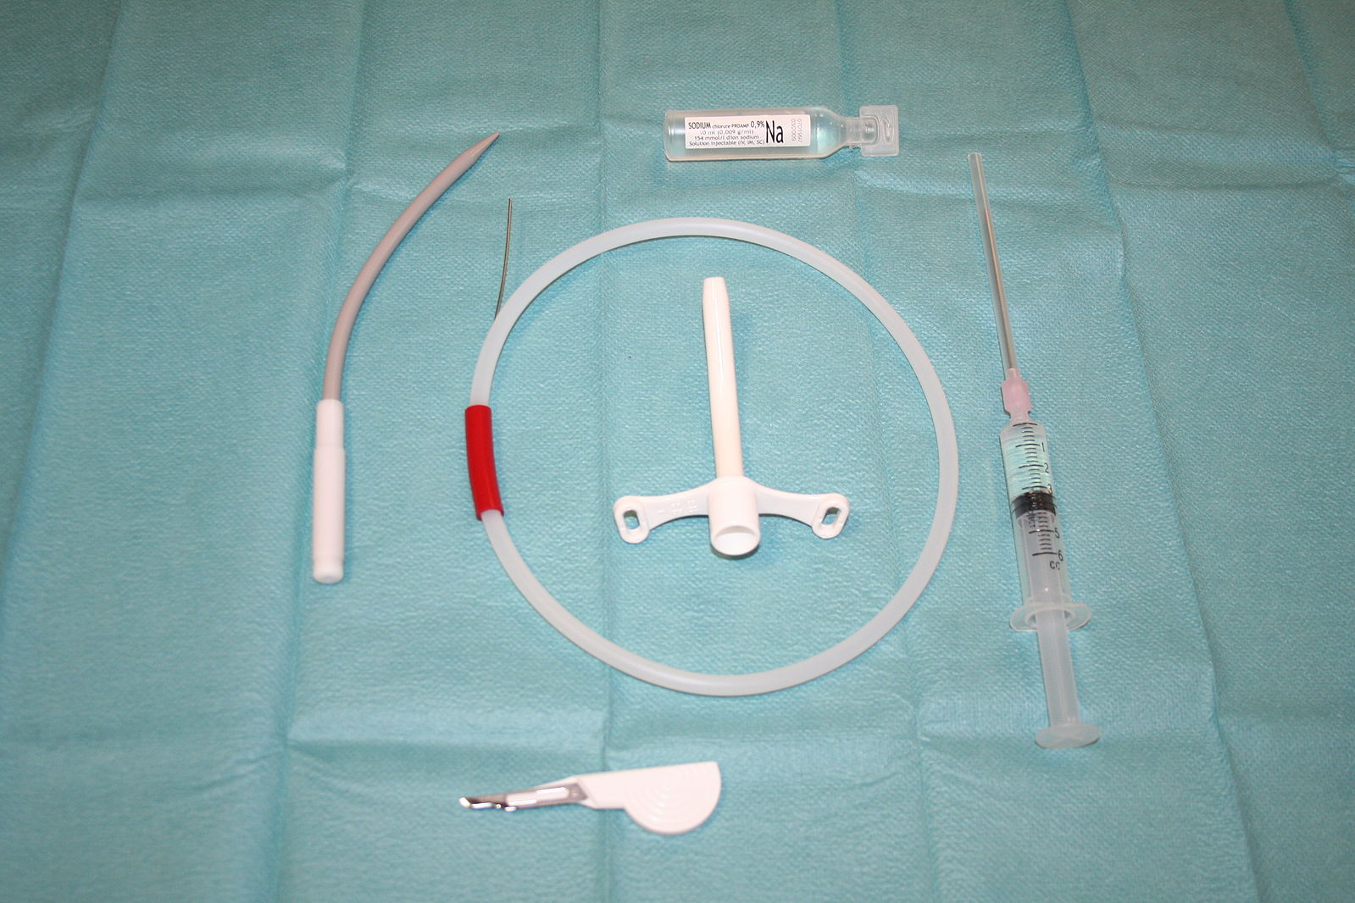
Needle Cricothyroidotomy
Provides oxygen on a short-term basis until definitive airway can be placed
Seldinger technique
Insertion of needle through cricothyroid membrane into trachea
Large-caliber plastic cannula placed
through cricothyroid membrane into trachea
Cannula connected to oxygen at 15L/min via
y-connector
Intermittent insufflation
Notes:
Open Access Image:
https://en.wikipedia.org/wiki/Tracheal_intubation

Slide 25
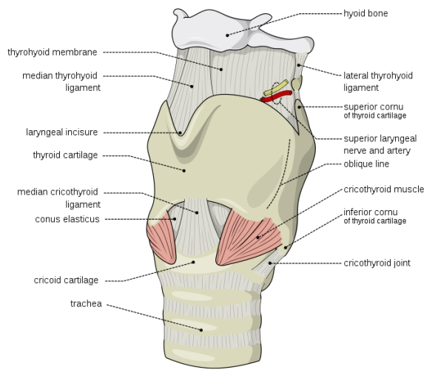
Surgical Cricothyroidotomy
Palpate the thyroid notch, cricothyroid interval, and sternal notch for orientation
Stabilize the thyroid cartilage with left hand and maintain stabilization until the trachea is intubated
Make a transverse incision (obese patient use a vertical incision) over the cricothyroid membrane and incise through the membrane transversely.
Insert hemostat or tracheal spreader into incision and rotate 90 degrees to open airway
Insert proper-sized, cuffed endotracheal tube into cricothyroidmembrane
Inflate cuff and apply ventilation
Observe and ascultate for lung inflation and end tidal CO2
Secure tube
Notes:
Open Access Image:
https://en.wikipedia.org/wiki/Cricothyrotomy

Slide 26
Airway Decision Scheme
Pre-oxygenate
O2 +/- bag mask +/- oral airway +/- nasal airway
Call for help, if available
Consider adjuncts:
LMA, LTA
Difficult
Assess airway anatomy for ease of intubation
YES
Easy
Able to oxygenate?
Intubation
NO
Definitive Airway
Surgical Airway
Unsuccessful
Consider adjuncts:
LMA, LTA
Definitive airway/ Surgical airway

Slide 27
Initial Trauma Assessment
Adaptations for Resource Limited Settings
Kampala Advanced Trauma Care Course
Last Edited August 2016 by Maija Cheung MD & Michael DeWane MD

Slide 28
Limited Resource Settings
Unfamiliar with tracheal intubation
Remember adjuncts:
Bag valve mask
Oropharyngeal airway – helpful when airway obstruction caused by tongue
Laryngeal mask airway
Nasopharyngeal airway
No ventilator
Consider early tracheostomy
Absence of proper sized tracheostomy tube
Can use appropriately sized endotracheal tube instead
Notes:
Need source for picture

Slide 29
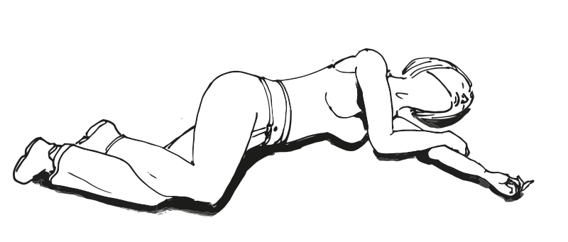
Limited Resource Settings
Recovery Position
May be appropriate for long transports without monitoring, no airway personnel available, no airway adjuncts available
Notes:
Open Access Picture:
https://commons.wikimedia.org/wiki/File:Recovery_position.svg

Slide 30
Initial Trauma Assessment
Case Study
Kampala Advanced Trauma Care Course
Last Edited August 2016 by Maija Cheung MD & Michael DeWane MD

Slide 31
Case:
A 22 year old boda boda driver is brought in after crashing into a ditch. He was not wearing a helmet, smells of waragi and has significant facial trauma. He responds only to painful stimuli.
What are the initial management steps for care of this patient?
- ABC’s
- Airway: intubate for GCS<8

Slide 32
Useful Resources
Trauma.org
Trauma Care Manual - Ian Greaves, Keith Porter, Jim Ryan
Trauma Management- Demetrios Demetriades, Juan A. Asenio

Slide 33
Collaborators
Maija Cheung, MD - Yale General Surgery Resident
Michael DeWane, MD - Yale General Surgery Resident
Naomi Kebba, MD – Surgeon, Uganda Heart Institute
Michael Lipnick, MD - UCSF Anesthesiologist
Doruk Ozgediz, MD - Yale Pediatric Surgeon
Lameck Semogerere, MD
Last Edited February 2017 by Maija Cheung MD & Michael DeWane MD

