Slide 1
Musculoskeletal Trauma
Kampala Advanced Trauma Care Course

Slide 2
Outline
Global context
Epidemiology & Local epidemiology
Management strategies/ Ideal treatment
Adaptations for resource-limited settings/ context appropriate treatment
Case Study

Slide 3
Global context and epidemiology
High morbidity and mortality with musculoskeletal injuries
Mortality in all patients with pelvic fracture is 5-30%
Open pelvic fracture mortality ~ 50%
5% of patients with brain injury also have spinal injury
25% of patients with spinal injury also have at least mild brain injury

Slide 4
Local Epidemiology:
70% of Trauma at Mulago Hospital involves musculoskeletal injuries
These can be life threatening especially when involving pelvic bleeding
Musculoskeletal injuries are rarely included in the primary survey and therefore are often missed and have a high morbidity
Notes:
Local Stats?

Slide 5
Initial Trauma Assessment
Initial Assessment
Kampala Advanced Trauma Care Course
Last Edited August 2016 by Maija Cheung MD & Michael DeWane MD

Slide 6
ABC’s!
Do NOT re-order the priorities of resuscitation (ABC’s)
Continued reevaluation of the patient is necessary to identify all injuries.
During the primary survey: recognize and control hemorrhage from musculoskeletal injuries
Control hemorrhage by direct pressure
Fluid resuscitate!

Slide 7
Adjuncts to Primary Survey:
Fracture immobilization
Goal: realign injured extremity into anatomic position
Splinting of closed fractures may decrease bleeding by reducing motion and enhancing tamponade effect
Open fractures: apply sterile pressure dressing temporarily, will require surgical debriement
Check pulses before and after re-alignment/ splinting
X-ray
Usually part of secondary survey but can be done earlier depending on clinical findings
If obvious deformity and lack of pulses do NOT wait for imaging to realign extremity

Slide 8
Secondary Survey:
History:
Mechanism of injury
MVC – pre and post-crash location of patient, vehicle damage, restrained?
Environment
Prehospital interventions/ care
Physical Exam with special attention to:
Skin (protects patient from excessive fluid loss and infection)
Neuromuscular function
Circulatory status (palpate distal pulses, assess capilary refill)
Skeletal and ligamentous injury (excessive pain may mask abnormal motion)
Limb length discrepancy

Slide 9
Initial Trauma Assessment
Common Musculoskeletal Injuries & Management
Kampala Advanced Trauma Care Course
Last Edited August 2016 by Maija Cheung MD & Michael DeWane MD

Slide 10
Pelvic Injuries:
High energy injuries
High mortality when associated with hypotension and bleeding
Usually result from MVCs and falls
Disruption of pelvic ring tears pelvic venous plexus and occasionally internal iliac arterial system (85% are venous bleeds)

Slide 11
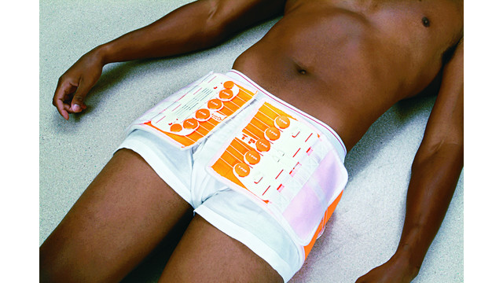
Pelvic Injury Management:
Hemorrhage control & fluid resuscitation & pain control
Monitor and transfer for definitive care if necessary – surgical consult
Mechanical stabilization of pelvic ring and external counterpressure
Pelvic binder at level of greater trochanters of femur
External fixation, ORIF
May require laparotomy or angiography
Trans-arterial embolization
Pelvic packing in OR
Notes:
Open Access Image:
http://www.emsworld.com/article/10287441/orthopedic-trauma

Slide 12
Spinal Trauma:
Spinal Injury Distribution
55% cervical region
15% thoracic region
15% thoracolumbar junction
15% lumbosacral area
Excessive manipulation and inadequate immobilization may cause additional neurologic damage and worsen patient outcome
As long as patient’s spine is protected, evaluation of spine and exclusion of spinal injury may be safely deferred especially in presence of systemic instability such as hypotension and respiratory distress

Slide 13
Spinal Assessment/ Management:
Neuromuscular exam with strength grading
Rectal exam
Dermatomes
Reflexes
All patients with radiographic evidence of injury and those with neurologic deficits should be considered to have an unstable spinal injury
Immobilize and maintain logroll precautions until after consultation with neurosurgeon or orthopedic surgeon

Slide 14
Spinal Management Continued:
Shock:
May be hemorrhagic or spinal shock
Rule out hemorrhage and other causes of hypotension
Fluids, trendelenberg
If bradycardic, this may be a sign of c-spine injury
MAP goal >60 to maintain good spinal cord perfusion
Radiology
X-rays, CT, MRI
Immobilize
Neurosurgery or orthopedic surgery consult
Traction if necessary

Slide 15
Spinal Cord Injuries:
Spinal shock
Loss of muscle tone and reflexes after spinal cord injury
Classified according to:
Level
Severity (complete/ incomplete)
Spinal cord syndromes (anterior cord syndrome, central cord syndrome, Brown-Sequard syndrome)
Morphology

Slide 16
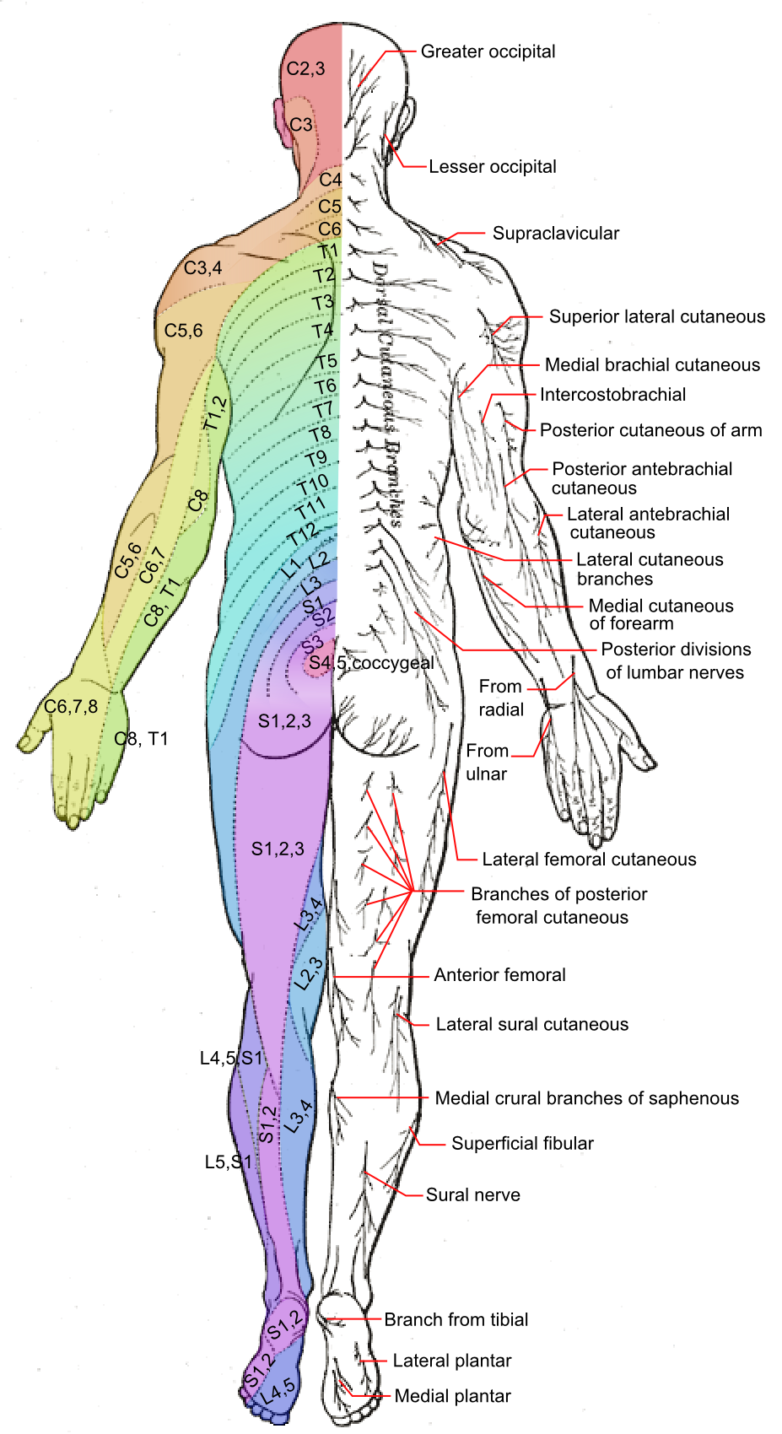
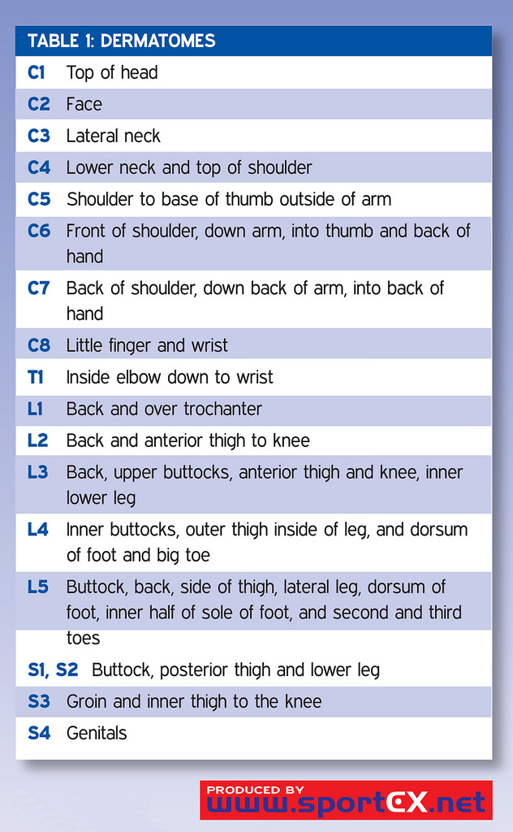
Dermatomes
Notes:
Open Access Images:
https://en.wikipedia.org/wiki/Axial_line_(dermatomes)
https://www.flickr.com/photos/sportex/3947892790

Slide 17
Life-threatening Extremity Injuries:
Major arterial hemorrhage
Control hemorrhage – careful use of tourniquet may be helpful/ lifesaving
Surgical consult
Assess and re-assess pulses frequently
Direct pressure if open wound
Open wounds with fracture ->realign, splint, direct pressure
Fluid/ blood resuscitation
Crush Syndrome (Traumatic Rhabodomyolysis)
Direct muscle injury -> muscle ischemia -> cell death -> release of myoglobin -> elevated creatine kinase -> acute renal failure -> DIC
Lab tests: myoglobin assay, electrolyte levels, lactate
Aggressive fluid repletion: maintain urine output at 100 ml/hr

Slide 18
Compartment Syndrome
Increased pressure in osteofascial compartment of muscle causes ischemia and subsequent necrosis with possible loss of limb
Occurs if increase in compartment size (swelling) or decrease in compartment size (constrictive dressing).
High Risk Injuries
Tibial and forearm fractures
Injuries immobilized in tight casts or dressings
Severe crush injury to muscle
Revascularization of ischemic extremity
Localized, prolonged external pressure
Burns
Excessive exercise

Slide 19
Compartment Syndrome Signs and Symptoms:
Pain out of proportion
Palpable tenseness of compartment
Pain on passive stretch of the affected muscle
Asymmetry of muscle compartments
Absence of palpable distal pulse (late finding)
Increased intra-compartmental pressure (>30 mmHg)

Slide 20
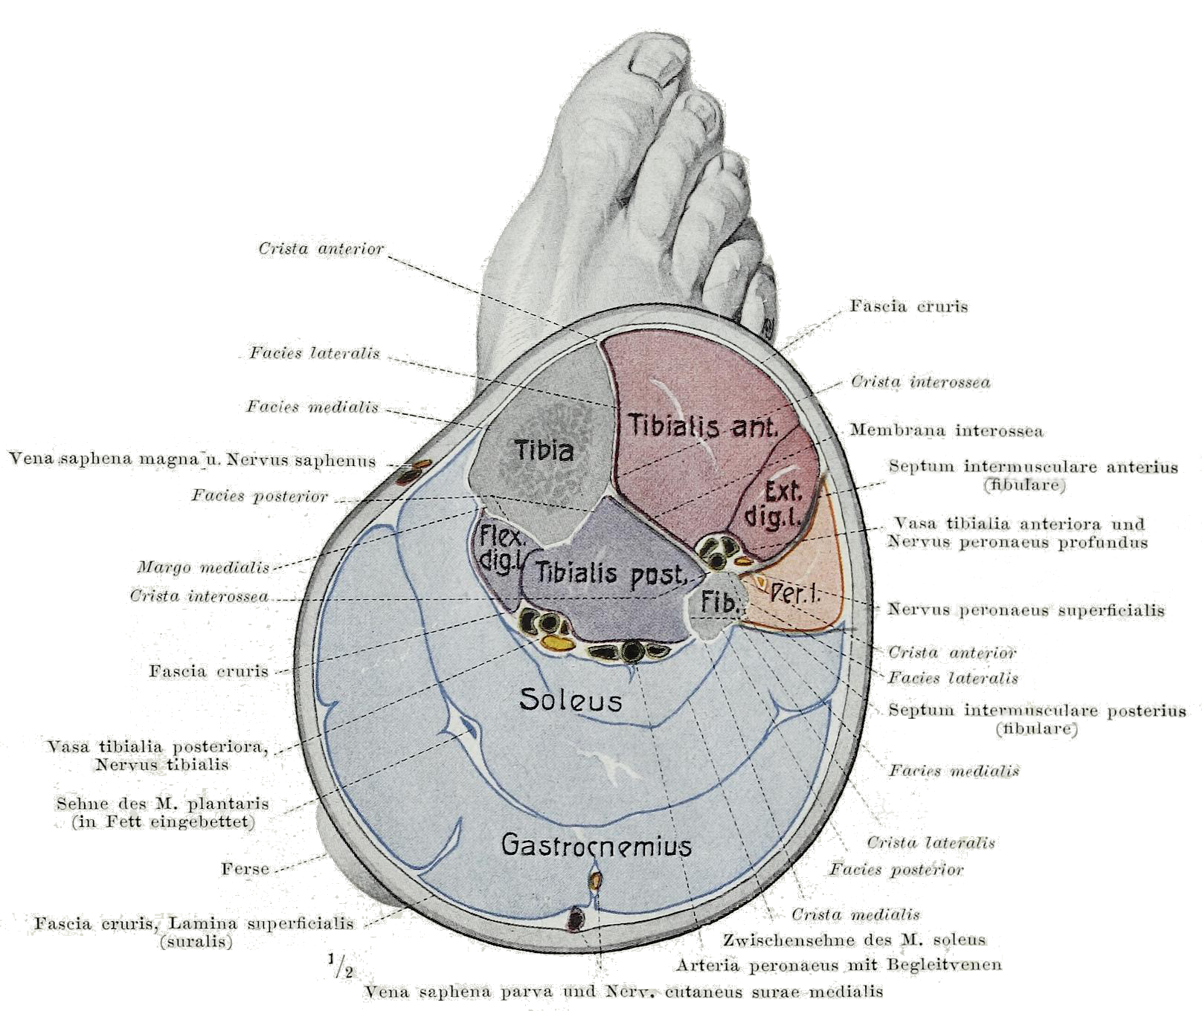
Compartment Syndrome Management:
Early Surgical Consult
Remove constrictive dressings (casts, bandages, splints)
Urgent fasciotomy
Notes:
Open Access Image:
https://en.wikipedia.org/wiki/Calf_(leg)

Slide 21
Open Fractures:
Open fractures
Communication between external environment and the bone = CONTAMINATED
Must have damage to skin and bone to occur
High energy injuries
Prone to problems with infection, healing, function
Do NOT probe wounds
Continue to resuscitate patient!

Slide 22
Open Fractures Management:
Immobilize, restore normal anatomy, assess pulses, sterile dressing
Surgical consult for debridement, stabilization
ALL patients with open fractures should get a tetanus immunization, and should be treated with intravenous antibiotics as soon as possible. (First generation cephalosporins)
Assess viability of limb for salvage vs. amputation

Slide 23
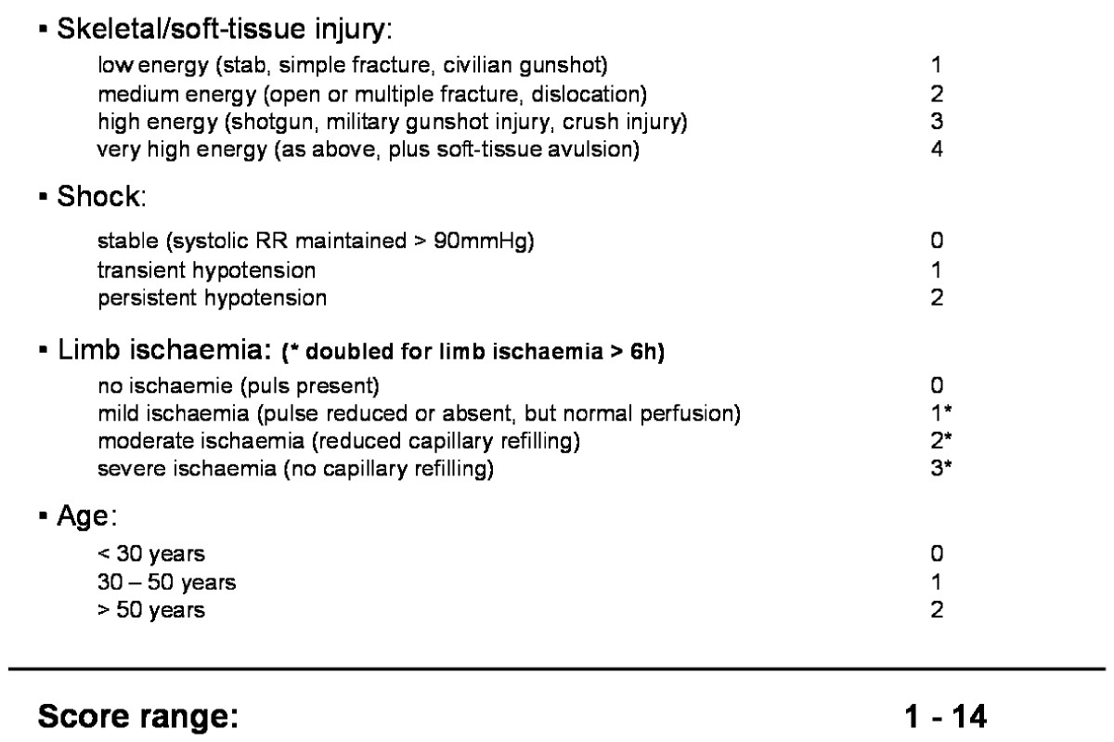
Mangled Extremity
Mangled extremity severity score (MESS)
Guides decision between amputation and limb salvage in severe soft tissue injuries
MESS >7 correlates strongly
with amputation

Slide 24
Initial Trauma Assessment
Adaptations for Resource Limited Settings
Kampala Advanced Trauma Care Course
Last Edited August 2016 by Maija Cheung MD & Michael DeWane MD

Slide 25
Adaptations to Resource Limited Settings:
Pelvic Fracture Management without Embolization:
Use pelvic binder – can use a sheet from the ward
External fixation available at Mulago Hospital
Concern for Compartment Syndrome and unable to measure pressures:
Palpate the affected limb compartments and feel for tension in the tissues; if compartments are tense this should raise concern and fasciotomy should be considered
Limb Salvage vs. Amputation Considerations:
Limb salvage should be considered at all times if viable
Remember mangled extremity severity score >7 correlates strongly with amputation

Slide 26
Initial Trauma Assessment
Case Study
Kampala Advanced Trauma Care Course
Last Edited August 2016 by Maija Cheung MD & Michael DeWane MD

Slide 27
Case:
A wall collapses on a 40 year old male worker. Vital signs are blood pressure 130/75, heart rate 110, respiratory rate 22, GCS 15. He has a painful bruised, and deformed right leg.
What are the initial steps in management?

Slide 28
Useful Resources
Trauma.org
Trauma Care Manual - Ian Greaves, Keith Porter, Jim Ryan
Trauma Management- Demetrios Demetriades, Juan A. Asenio

Slide 29
Collaborators
Peter Muwanguzi, MBChB, MMed Orthopedics
Martha Namugga, MD, MMed General Surgery
Sarah Ullrich, MD - Yale General Surgery Resident
Maija Cheung, MD - Yale General Surgery Resident
Michael DeWane, MD - Yale General Surgery Resident
Naomi Kebba, MD – Surgeon, Uganda Heart Institute
Michael Lipnick, MD - UCSF Anesthesiologist
Doruk Ozgediz, MD - Yale Pediatric Surgeon
Rodney Mugarura, MD – Orthopedic Surgeon, Mulago Hospital
Kakyama Moses, MD – Orthopedic Surgeon, Mulago Hospital
Alex Bangirana, MD – Orthopedic Surgeon, Mulago Hospital
Last Edited April 2019 by Dr. Peter Muwanguzi

