Slide 1





Pediatric Trauma
Kampala Advanced Trauma Care Course

Slide 2
Outline
Global context
Epidemiology & Local epidemiology
Pathophysiology
Management strategies/ Ideal treatment
Adaptations for resource-limited settings/ context appropriate treatment
Case for discussion

Slide 3
Global context and epidemiology
Injury is the most common cause of death and disability in childhood worldwide surpassing all major diseases in children and young adults.
Motor vehicle associated injuries are the most common cause of death in children of all ages.
8% of all injuries in children involve the chest
  Chest injury serves as a marker for other organ system injury since >2/3rds of children with chest injury will have multiple injuries

Slide 4
LMIC Epidemiology
Road traffic crashes involving pedestrians predominate in most African trauma registries
Children compose >50% of the population in many of these countries
More children die of road traffic crashes than of TB, HIV, malaria combined in the age 5-14 year age group
Falls are more common in children under the age of 1

Slide 5
Pediatric Injuries
Mulago Hospital Uganda 2005
Notes:
Epidemiology of injuries presenting to the national hospital in Kampala, Uganda: implications for research and policy
Renee Y. Hsia & Doruk Ozgediz & Milton Mutto & Sudha Jayaraman & Patrick Kyamanywa &
Olive C. Kobusingye
Int J Emerg Med (2010) 3:165–172 DOI 10.1007/s12245-010-0200-1

Slide 6
Initial Trauma Assessment
Pediatric Trauma
Unique Issues/ Pathophysiology
Kampala Advanced Trauma Care Course
Last Edited August 2016 by Maija Cheung MD & Michael DeWane MD

Slide 7
Unique Problems in Children:
Blunt trauma and children’s physical characteristics result in multisystem injury being much more common than single system injury.
Children may not demonstrate changes in hemodynamics until severe derangements are present.

Slide 8
Unique Problems in Children Continued:
Size
  Smaller mass = greater force per unit of body area
  Less fat, connective tissue, closer proximity to multiple organs = high frequency of multiple organ injury
  Large head proportionate to body = higher frequency of brain injuries
Skeleton
  Incompletely calcified = more flexible = internal organ damage without overlying bony fracture
Equipment
  Broselow Pediatric Emergency Tape (length-based resuscitation tape)
  Pediatric ETT

Slide 9
Unique Problems in Children Continued:
Surface Area
  Higher surface area/ body volume = greater heat loss and increased risk of hypothermia
    Temperature control: baer hugger, heat lamps, wrap arms and legs, warm IVF
Psychological Stress
  Trauma may lead to regressive psychological behavior
  Limited history taking and cooperation
Long-term effects
  Injury can have effects on subsequent growth and development

Slide 10
Normal Pediatric Vital Signs:
Resp Rate | Systolic Pressure | Pulse
30-60 | 60-90 | 95-145 | Neonate
30-60 | 75-100 | 125-170 | Infant
24-40 | 80-110 | 100-160 | Toddler
22-34 | 80-110 | 70-110 | Preschool
18-30 | 85-120 | 70-110 | School age
12-16 | 95-120 | 55-100 | Adolescent
Notes:
http://www.emedicine.com/med/topic3223.htm

Slide 11
Initial Trauma Assessment
Pediatric Trauma
Initial Assessment & Management
Kampala Advanced Trauma Care Course
Last Edited August 2016 by Maija Cheung MD & Michael DeWane MD

Slide 12
Case:
A 7 year old boy is struck by a moving car while crossing the street. He is unresponsive on arrival and breathing rapidly. Vital signs on admission are heart rate 144, respiratory rate 38, blood pressure 80/57, GCS 5 (E=1, V=2, M=2)
What are your initial steps in management?

Slide 13
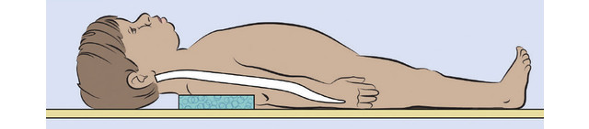
Pediatric Primary Survey:
Airway
  Anatomic Differences:
    Larger heads & tongues, smaller nasal passages
    Shorter trachea
      Infant trachea 5cms, 7cms at 18 months
      Failure to appreciate short length may result in intubation of right mainstem bronchus, inadequate ventilation
    Infant and Toddler disproportion between size of cranium and midface resulting in passive flexion of cervical spine caused by large occiput
      Place 1 inch thick padding beneath torso to preserve alignment of spinal column
Notes:
http://www.emsworld.com/article/10736962/pediatric-spinal-cord-injuries

Slide 14
Airway:
Fully pre-oxygenate before attempting mechanical ventilation
If oral airway needed do NOT use technique of inserting airway backward and rotating 180 degrees as trauma to soft tissue in oropharynx may occur
Approximate diameter of ETT to diameter of external nares or tip of child’s small finger or formula [(age +16)/4 = diameter]
Intubation Drugs:
  Sedation: etomidate or midazolam (0.3 mg/ kg in normvolemia or 0.1 mg/kg in hypovolemia)
  Paralytic: Succinycholine (2mg/kg in children <10 kg and 1mg/kg if >10 kg)

Slide 15
Breathing:
Know normals:
  Infant respiratory rate is 30-40
  Normal tidal volumes 4-6 mL/kg for infants and kids
Use pediatric bag-mask for children under 30 kg to avoid barotrauma
Hypoventilation causes respiratory acidosis = most common acid/base abnormality during resuscitation of injured children

Slide 16
Circulation:
Assess for signs of shock:
  Tachypnea
  Tachycardia
    may also be due to pain, fear, or psychologic stress
  Decreased cap refill, mottling
  Altered mental status
  Hypotension
    Increased physiologic reserve may result in maintenance of normal systolic blood pressure despite presence of shock
  Weakening of peripheral pulses
  Narrowing of pulse pressure to less than 20mm Hg

Slide 17
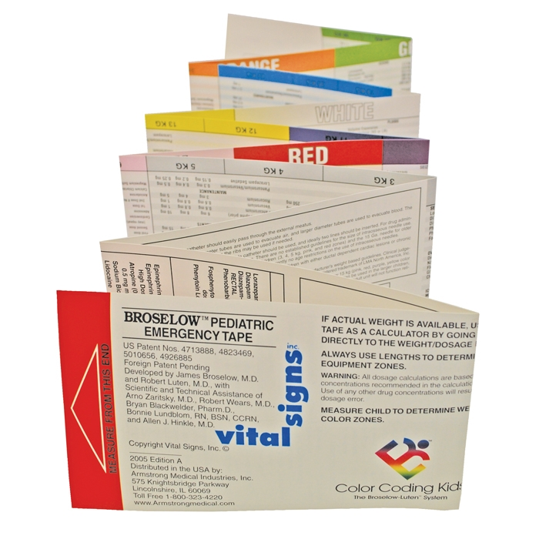
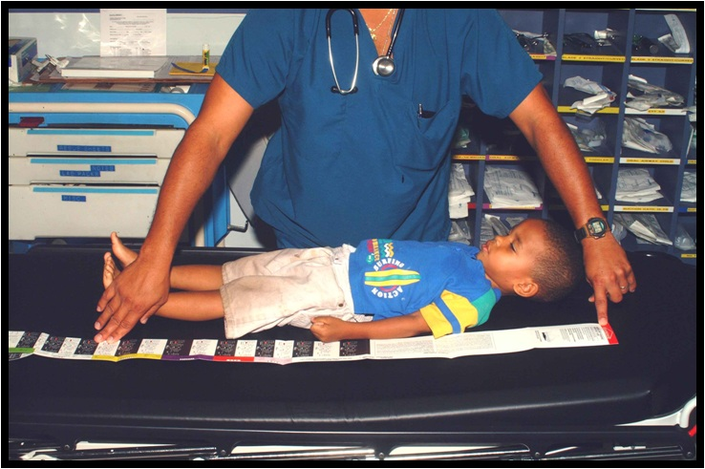
Circulation Continued:
Broselow Pediatric Emergency Tape:
  Provides approximate weight with fluid resuscitation
  volumes and drug doses
Also can estimate weight in kg [(2x age) + 10]
Fluid Resuscitation
  20 mL/kg bolus x3 if necessary
  10 ml/kg PRBCs if necessary
  Maintenance fluids: 4-2-1 Rule
    4ml/kg for first 10 kg, 2ml/kg for second 10 kg, 1ml/kg for every kg after 20
Notes:
Open Access Image:
https://en.wikipedia.org/wiki/Broselow_Pediatric_Emergency_Tape

Slide 18
Fluid Resuscitation Continued:
Adequate resuscitation indicated by:
  Urinary output of 1-2 ml/kg/hr
  Urine specific gravity return to normal
  Slowing of heart rate to normal
  Clearing of sensorium
  Return of peripheral pulses
  Return of normal skin color
  Increased warmth of extremities
  Normalization of blood pressure

Slide 19
Resuscitation Algorithm:
Child in Shock
Get early surgical consult!
20cc/kg crystalloid bolus
(may repeat x3)
Stable
Remains Unstable
10cc/kg bolus of blood
Further evaluation
Stable
Unstable
OR

Slide 20
C-spine Injuries:
Spinal Cord Injury Without Radiographic Abnormality (SCIWORA)
  Occurs in up to 67% of pediatric spinal cord injuries
  Pediatric spine
    Increased elasticity of joint capsules and ligaments
    Disproportionate size of the head
    Weak cervical musculature
  Spinal cord may be completely disrupted without apparent disruption of the vertebral elements by plain films or CT scans
  MRI is more sensitive
Immobilize, Immobilize, Immobilize

Slide 21
Spinal Cord Injuries Contiued:
Spinal Cord Injury
  Only 5% of spinal cord injuries occur in pediatric population
  More flexible interspinous ligaments and joints
  Can have pseudosubluxation with C2 seemingly anterior displaced on C3
  Skeletal growth centers can resemble fractures
  When in doubt about the integrity of the cervical spine or spinal cord, assume that an unstable injury exists and maintain immobilization of head and neck and obtain surgical consult

Slide 22
Head Injuries:
75% of all pediatric trauma deaths are due to head injury
Most common mechanisms are MVCs, falls, bicycle crashes, child maltreatment
  Abuse is most common cause of severe head injury in children < 2 yrs
  MVC’s are most common cause for all ages
Results in diffuse rather than focal injury
Most head injuries are preventable (up to 90%)

Slide 23
Head Injuries Continued:
Infants with open fontanelles and mobile cranial sutures have more space for brain swelling – therefore treat bulging fontanelles or suture diastases in infants as a more severe injury
Impact seizures (occurring shortly after brain injury) more common in children and are usually self limited but all seizures require CT scan

Slide 24
Chest Injuries:
Can have pulmonary contusions without associated rib fractures due to incompletely calcified rib cage
Mobility of mediastinal structures makes children more susceptible to tension pneumothorax, the most common immediately life threatening injury in children
Bronchial and diaphragmatic injuries more common in children, injuries to great vessels less common

Slide 25
Abdominal Injuries:
Consult Surgeon Early!
More common in Pediatrics:
  Blunt pancreatic injuries
  Small bowel injuries (duodenal hematoma, small bowel avulsion, perforation near ligament of Treitz)
    Enteric injuries may be associated with flexion-distraction (Chance) fracture of the lumbar spine (associated with seat-belt restraint)
  Bladder ruptures

Slide 26
Abdominal Injuries Continued:
Non-operative Management of Solid Organ Injuries (Liver, Spleen, Kidney)
  Admit to ICU for observation, serial exams, serial Hct’s
  NPO x 24 hours or until normal hemodynamics.
  Strict bedrest generally grade + 1
  Gradually advance diet and activity
  No contact sports or exertional activities for 3 months
Indications for OR
  Peritonitis, clinical deterioration
  Hemodynamic instability unresponsive to IVF/blood resuscitation

Slide 27
Musculoskeletal Injuries:
Immature, pliable bones may lead to greenstick fractures
  Incomplete fracture with angulation maintained by cortial splinters on concave surface
X-rays
  Growth plate involvement?
  Displacement?
  Dislocation?
Splint and immobilize until definitive orthopedic evaluation
Any evidence of unusual behavior – unwillingness by child to use arm or bear weight on extremity should be evaluated for occult injury.

Slide 28
Non-Accidental Trauma/ Mistreatment:
Most common age <3
Clues:
  Inconsistent history
  Prolonged time interval from injury to presentation
  Injury patterns
    Fractures and bruises of different ages
    Lower extremity fractures in children who cannot walk
    Posterior rib fractures
    Burns that do not fit history
    Signs of suffociation
    Signs of hypothermia and frostbite
    Retinal hemorrhages
    Bizarre injuries – cigarette burns, bites, rope marks

Slide 29
Initial Trauma Assessment
Pediatric Trauma
Injury Prevention
Kampala Advanced Trauma Care Course
Last Edited August 2016 by Maija Cheung MD & Michael DeWane MD

Slide 30
Injury Prevention:
Selected LMIC Examples:
  Speed bumps
  Traffic enforcement
  School crossings
  Prevention of falls from mango trees
  Stoves rather than open fires
  Drowning prevention
    Teach swimming in seaside/ lakeside communities

Slide 31
Initial Trauma Assessment
Adaptations for Resource Limited Settings
Kampala Advanced Trauma Care Course
Last Edited August 2016 by Maija Cheung MD & Michael DeWane MD

Slide 32
Adaptations for resource-limited settings:
Non-operative management of Abdominal Injuries in Pediatrics:
Controversial in settings with limited monitoring + intensive care, and lack of imaging beyond ultrasound
  Reasonable to attempt non-operative approach in hemodynamically normal patient with known solid organ injury.
  If transfusion of 40% or more of blood volume is needed, may require laparotomy
  Require close monitoring and true “serial exam”
  Must be prepared to mobilize OR quickly (ie have the phone number of the anesthetist)
  Majority who require laparotomy will do so within 6 hours of injury

Slide 33
Adaptations for resource-limited settings:
No fluid pumps or pediatric size fluid bottles
  Danger is overhydration
  Give fluid boluses every 2 hours as opposed to letting drip run unattended
  Can use syringe to give bolus
Hypothermia
  Large polyethylene paper can be put between sheets to encourage heat retention and used to cover child
  Put warm water in plastic gloves and pack around child’s body

Slide 34
Initial Trauma Assessment
Case Study
Kampala Advanced Trauma Care Course
Last Edited August 2016 by Maija Cheung MD & Michael DeWane MD

Slide 35
Case:
A 7 year old boy is struck by a moving car while crossing the street. He is unresponsive on arrival and breathing rapidly. Vital signs on admission are heart rate 144, respiratory rate 38, blood pressure 80/57, GCS 5 (E=1, V=2, M=2)
What are your initial steps in management?

Slide 36
Useful Resources
Trauma.org
Trauma Care Manual - Ian Greaves, Keith Porter, Jim Ryan
Trauma Management- Demetrios Demetriades, Juan A. Asenio

Slide 37
Collaborators
Maija Cheung, MD - Yale General Surgery Resident
Michael DeWane, MD - Yale General Surgery Resident
Naomi Kebba, MD – Surgeon, Uganda Heart Institute
Phyllis Kisa, MD – Pediatric Surgeon, Mulago Hospital
Michael Lipnick, MD - UCSF Anesthesiologist
Doruk Ozgediz, MD - Yale Pediatric Surgeon
Last Edited February 2017 by Maija Cheung MD & Michael DeWane MD

